Slide 1

Automatic Detection of Parkinson’s Disease Using Gait Signals
Saranya Bhattacharjee (aj81owid)
MSc Artificial Intelligence
Project Time Series, Pattern Recognition Lab
Supervisor: Dr.-Ing. Tomás Arias-Vergara

Slide 2
Talk Overview:
Introduction & Motivation
Related Work
Dataset Overview and Analysis: PhysioNet
TSFresh-Feature Extraction and PCA Preparation Pipeline
PCA Visualization of Extracted Gait Features
Machine Learning Framework
Results & Key Findings
Conclusions, Limitations & Future Work
Q&A

Slide 3
Introduction and Motivation
Parkinson's Disease · Automated Gait Analysis
10M+
2nd
UPDRS
vGRF
People affected worldwide
Most common neurodegenerative disorder
Subjective clinical rating scale
Objective gait biomarker
WHY AUTOMATE PD DETECTION?
Motor symptoms are measurable
Tremor, bradykinesia & instability directly alter gait force patterns
Clinical assessment is subjective
UPDRS scores vary by examiner — automated biomarkers reduce variability
vGRF signals are accessible
Force plates & wearables enable scalable, non-invasive PD screening
Research Question
"Can TSFresh-derived bilateral gait features reliably distinguish PD patients from healthy controls using classical ML classifiers?"

Slide 4
Related Work
Existing Approaches to PD Detection from Gait
Handcrafted Features + Classical ML
Unilateral / Per-Sensor Analysis
Ensemble ML, No Rigorous Validation
SIGNAL
Single trunk IMU (lower back, L5)
SIGNAL
Pressure insole + IMU, evaluated per sensor independently
SIGNAL
7 hand-picked — stride time,
cadence, pelvic kinematics, stability indexes.
PhysioNet vGRF — same dataset
(166 subjects)
FEATURES
FEATURES
Spatiotemporal gait parameters per
leg separately
FEATURES
Hypertuned RF + Ensemble
ACCURACY
>80% RF — single sensor only
Not directly reported for binary
PD vs HC
ACCURACY
86% — but no nested CV;
conflates binary classification
with severity regression
ACCURACY
Manual feature selection — no bilateral foot signal; multicollinearity risk; not reproducible across datasets
[1] Trabassi et al. (Sensors, 2022).
Bilateral gait asymmetry not captured — sensors evaluated independently, no cross-foot coordination modelled.
[2] Tsakanikas et al. (Sensors, 2023).
Results not comparable to subject-level binary classification; optimistic estimate without unbiased validation
[3] Navita et al. (Scientific Reports, 2025).
THIS WORK
TSFresh comprehensive features on bilateral vGRF → automated descriptors (autocorrelation, entropy, energy, RMS) → RF & SVM classifiers with nested CV → rigorous, interpretable baseline for future Mamba / SSM comparison
[1] Trabassi, D. et al. (2022). "Machine Learning Approach to Support the Detection of Parkinson's Disease in IMU-Based Gait Analysis." Sensors, 22(10), 3700.
[2] Tsakanikas, V. et al. (2023). "Evaluating Gait Impairment in Parkinson's Disease from Instrumented Insole and IMU Sensor Data." Sensors, 23(8), 3902..
[3] Navita et al. (2025). "Gait-Based Parkinson's Disease Diagnosis and Severity Classification Using Force Sensors and Machine Learning." Scientific Reports.

Slide 5
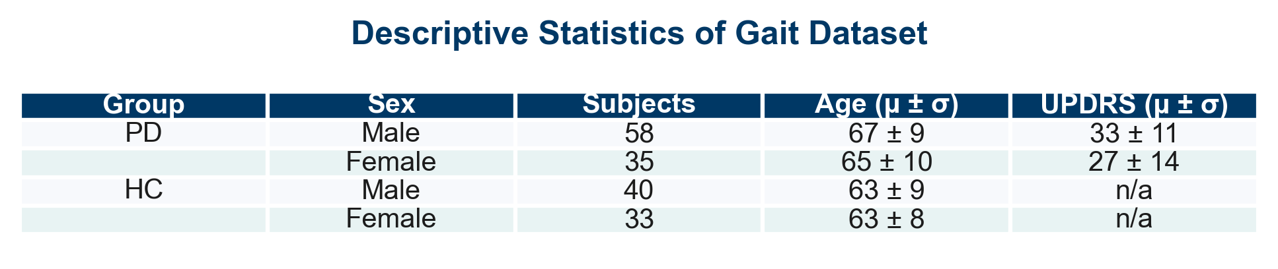
Dataset Overview: PhysioNet
Gait in Parkinson’s Disease Database (166 subjects — 93 PD, 73 healthy controls)
Contains vertical ground reaction force (vGRF) signals from 8 sensors per foot (16 total channels).
Recording duration: ~2 minutes of natural walking on an 8-force-plate walkway.
Sampling frequency: 100 Hz (≈ 12 000 samples per foot, ≈ 24 000 total per subject).
Clinical evaluation: Unified Parkinson’s Disease Rating Scale (UPDRS) for PD subjects.
Higher UPDRS scores indicate greater motor symptom severity.
Only usual-walking trials (‘01’) were used to ensure consistent gait conditions.

Slide 6
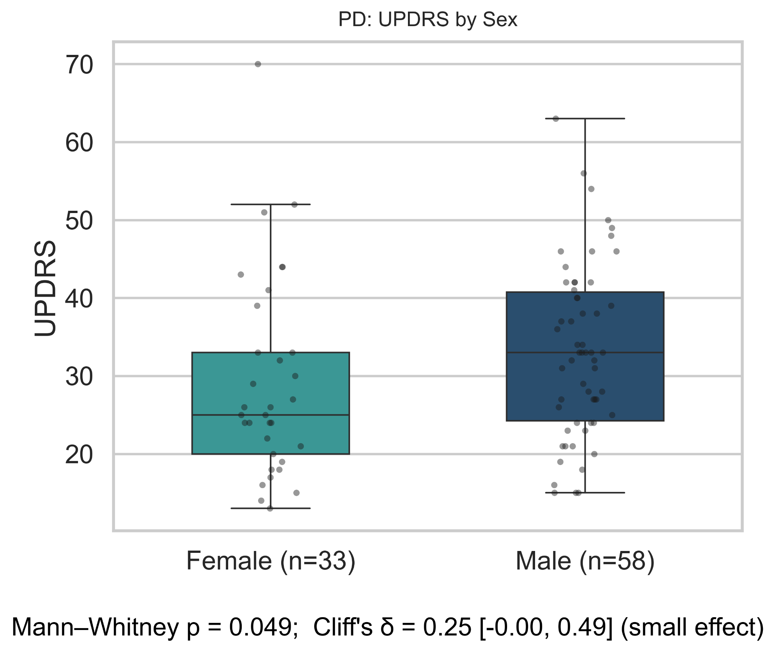
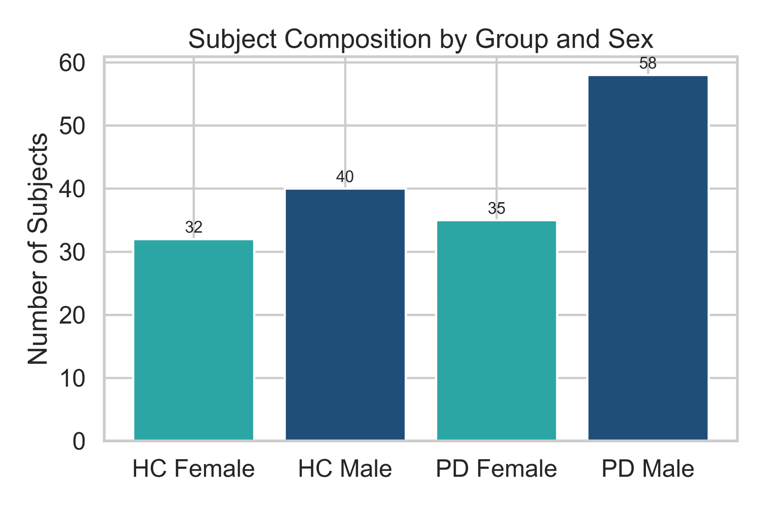
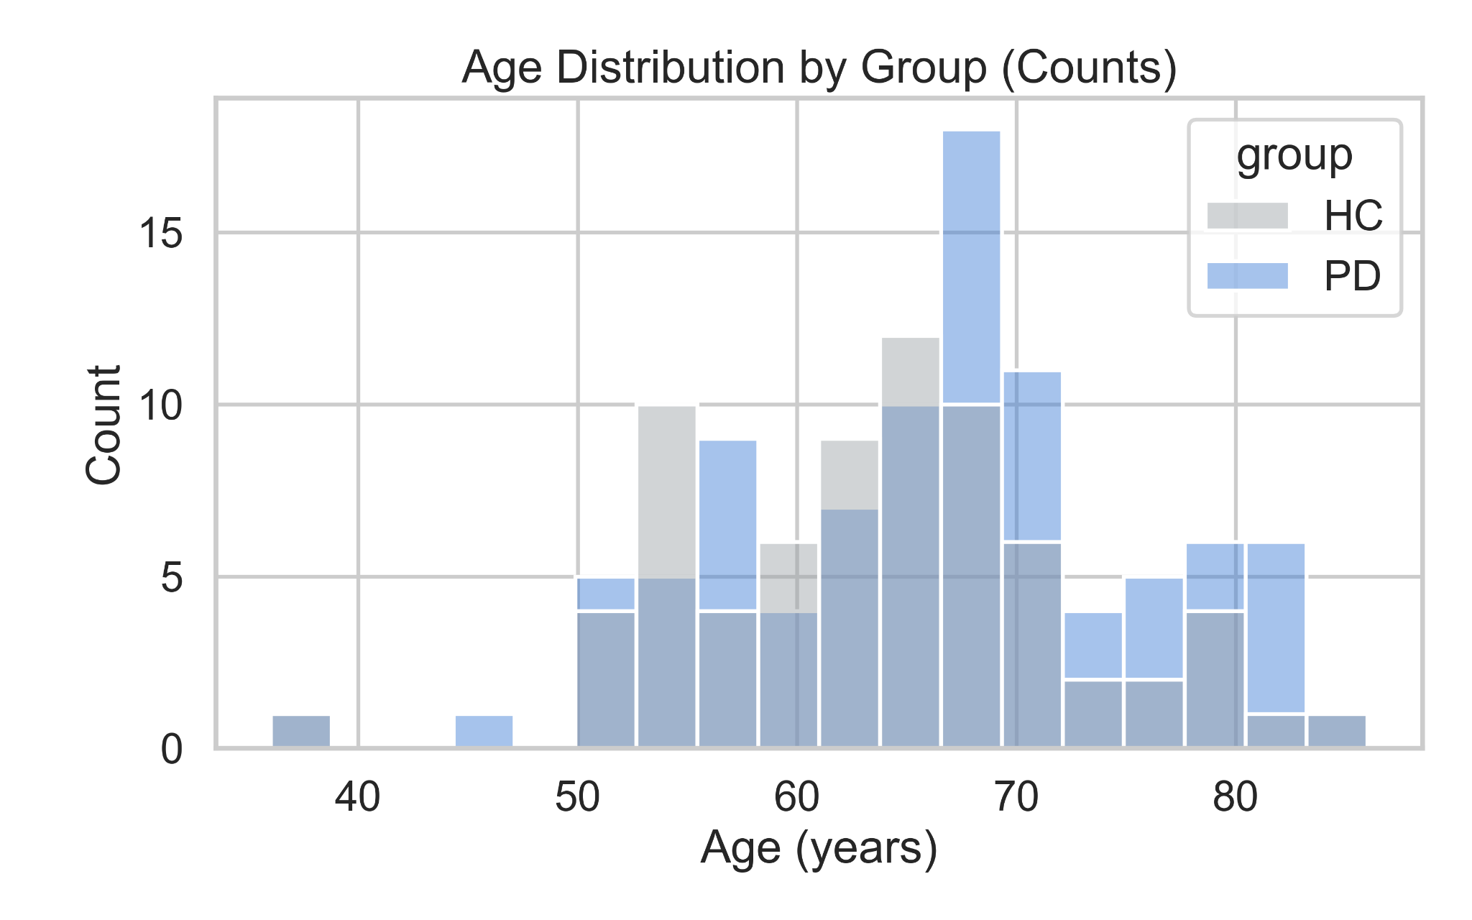
Dataset Overview: PhysioNet
Gait in Parkinson’s Disease Database (166 subjects — 93 PD, 73 healthy controls)
Balanced dataset with slightly higher representation of male PD participants.
PD and HC groups are closely age-matched, minimizing demographic confounds.
Male PD patients show slightly higher UPDRS scores and greater variability than females (p = 0.049; Cliff’s δ = 0.25, small effect), indicating marginally stronger motor impairment.

Slide 7
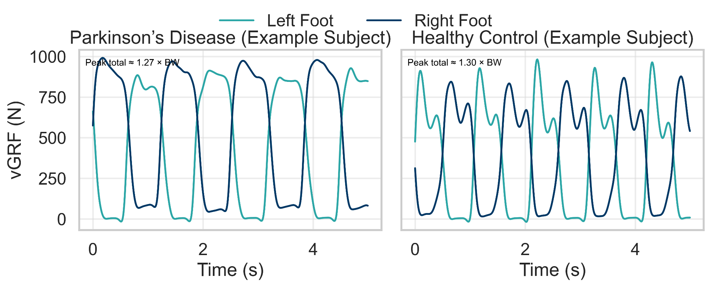
Example Vertical Ground Reaction Forces (vGRF) Cycles : Parkinson’s Disease vs Healthy Control
5-seconds segment sampled at 100 Hz (8 sensors per foot) - Usual walking (walk 01)
BW stands for Body Weight
Parkinson’s Disease (SiPt29, UPDRS = 70, 72 y, 0.86 m/s): Lower peak vGRF (near 1.27 × BW) and greater inter-limb asymmetry indicate reduced push-off force and impaired stance control, typical of bradykinetic gait.
Healthy Control (JuCo17, 65 y, 1.54 m/s): Balanced, rhythmic vGRF cycles with peaks near 1.30 × BW reflect stable gait rhythm and efficient weight transfer between limbs.
Observation: PD subject shows less consistent inter-limb timing and lower load transfer efficiency than HC, consistent with postural instability and reduced propulsion.

Slide 8
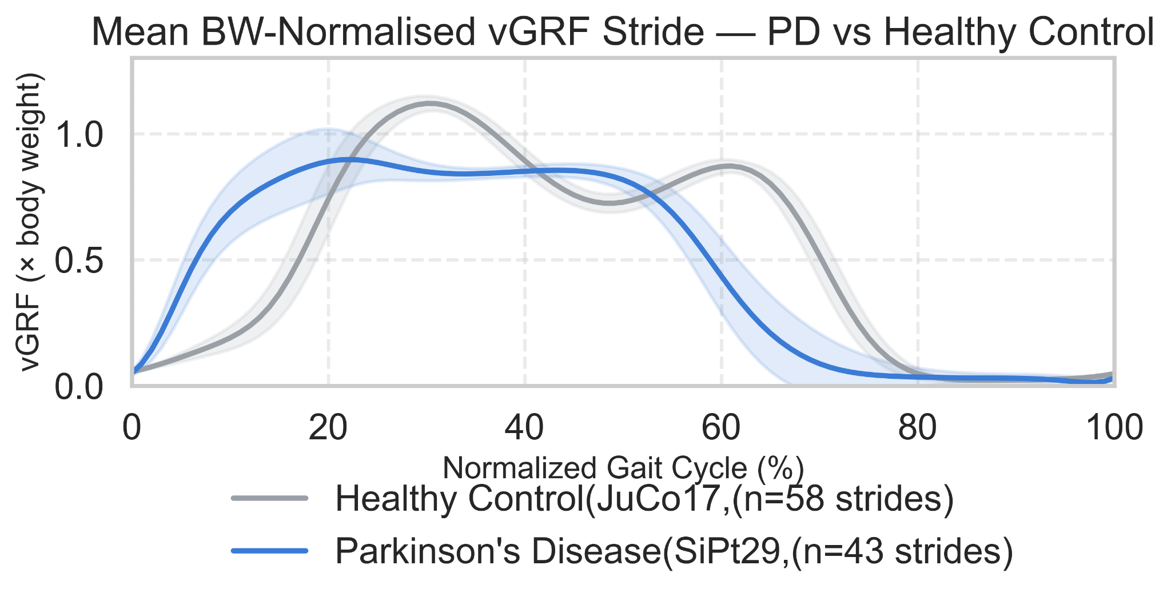
Mean Normalized vGRF Stride Comparison: Parkinson’s Disease vs Healthy Control
Normalized across 0–100% gait cycle, right foot (SiPt29 vs JuCo17)
PD subject (SiPt29) shows lower and flatter vGRF throughout the stride → reduced loading and propulsion.
Healthy Control (JuCo17) retains the two-peak pattern (heel strike + push-off) → rhythmic, symmetric gait.
PD displays merged peaks and greater variability (20–80 %) → unstable stance control.
Overall: PD gait = less amplitude, less symmetry, less efficiency.
Mean ± 1 SD across detected cycles per subject.
n denotes the number of detected gait cycles per subject used to compute the mean ± 1 SD curves.

Slide 9
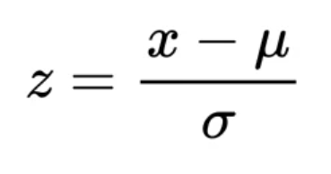
Feature Extraction and PCA Preparation Pipeline
Transforming raw vGRF signals into normalized, subject-level feature representations suitable for dimensionality-reduction analysis.
Preprocessing and Feature Extraction Steps
Process Summary:
Input: Raw vGRF (8 sensors / foot) sampled at 100 Hz ⬇ Segmentation: Sliding windows (300 ms window | 150 ms step) ⬇ Feature Extraction: TSFresh (e.g., autocorrelation, energy, entropy, RMS) ⬇ Aggregation: Mean | Standard Deviation | Skewness | Kurtosis. Aggregated per subject × foot → subject vector ⬇ Normalization & Dim-Reduction: Z-score → PCA / t-SNE visualization
Step | Description | Key Parameters / Notes
1. Signal Composition | Summed 8 load-cell forces per foot → total vertical GRF (vGRF). | Units: Newtons (N)
2. Windowing | Sliding windows across each signal to capture local gait dynamics. | 300 ms window, 150 ms step
3. Feature Extraction (TSFresh) | Extracted 60 + time-series descriptors (e.g., autocorrelation, energy, entropy, RMS). | Applied separately for Left and Right foot signals
4. Statistical Aggregation | Computed mean, standard deviation, skewness, kurtosis across windows per subject × foot. | Produces one feature vector per subject × foot
5. Normalization | Z-score normalization applied column-wise to remove scaling bias before PCA/t-SNE.
6. Feature Set Variants | Built three matrices for visualization: | • Left Foot only • Right Foot only • Combined (L + R concatenated)

Slide 10
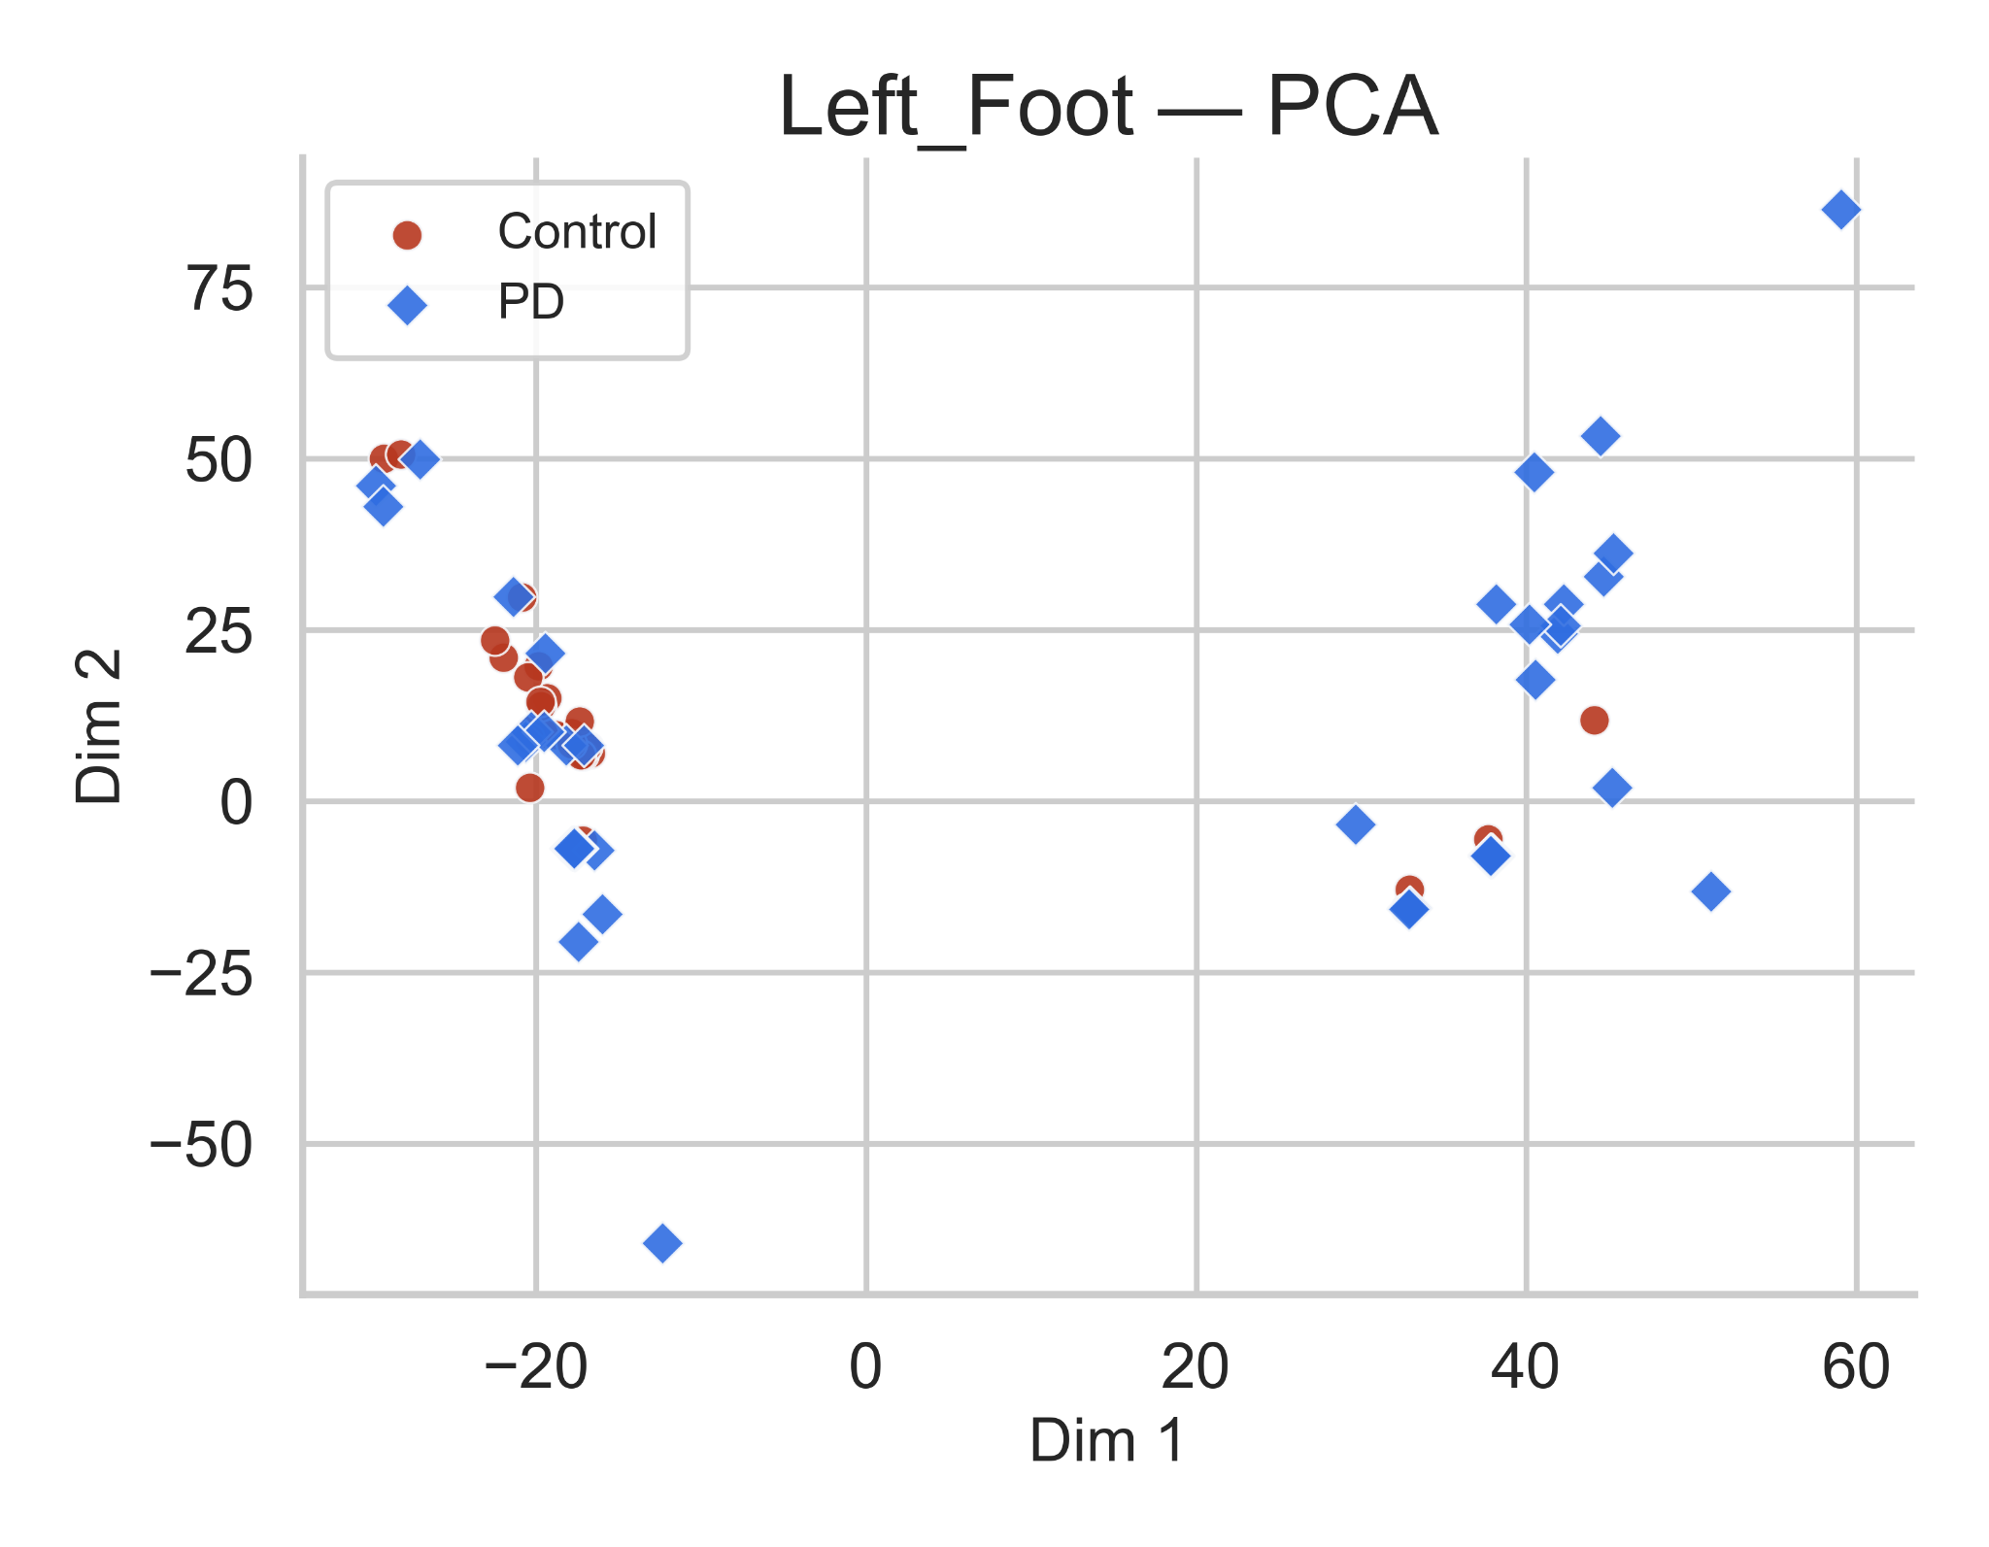
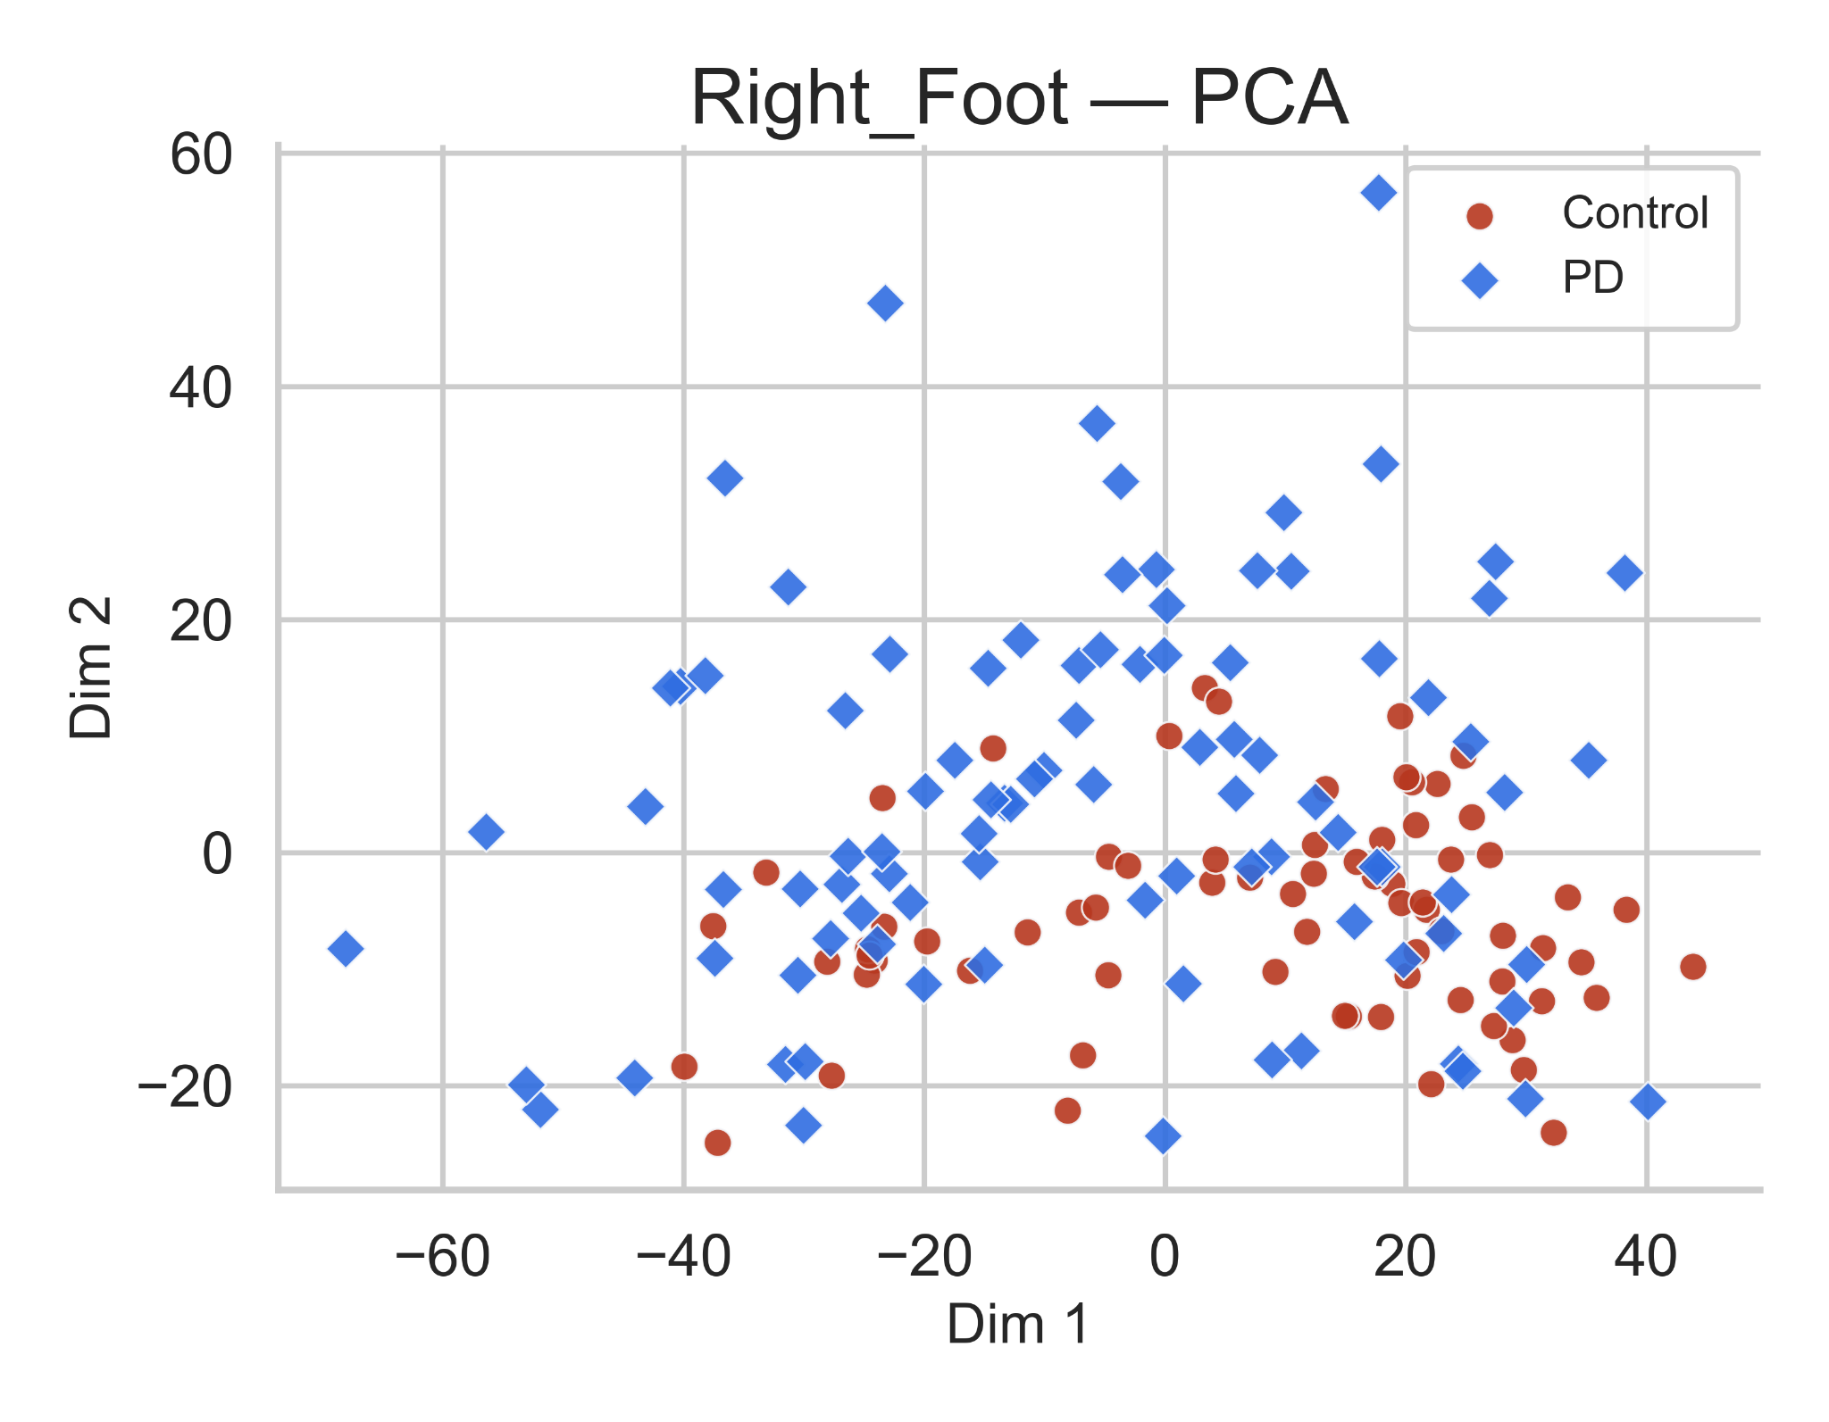
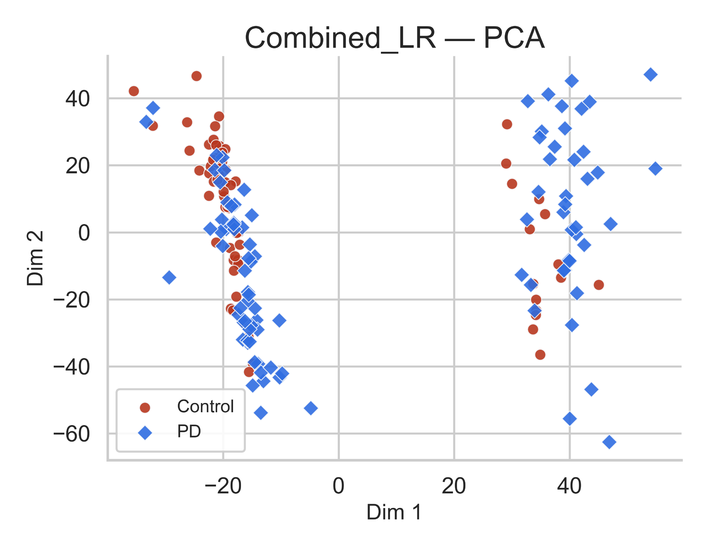
PCA Visualization of Extracted Gait Features
Evaluating how well TSFresh-derived gait features differentiate Parkinson’s Disease (PD) from Healthy Controls (HC) based on vGRF signals.
PD subjects are more spread out than controls → showing higher variability and less stable force control.
This could be linked to differences in how the affected side supports weight.
Here, both groups overlap quite a bit.
The right-foot features don’t show a clear difference, maybe because some PD participants use this side to compensate while walking.
When both feet are combined, the groups separate more clearly → capturing left–right coordination differences and overall gait asymmetry.
Takeaway: Left shows variability, right shows compensation, and combining both sides best highlights Parkinsonian gait asymmetry.

Slide 11
Baseline Machine Learning Pipeline
Feature Matrix → StandardScaler → PCA → GridSearchCV → Evaluation
1 INPUT
TSFresh features — Left / Right / Combined
Already aggregated at subject level
DESIGN DECISIONS AND WHY
Nested CV (not simple holdout)
n=166 is too small. Simple CV gives optimistic estimates; nested separates tuning from evaluation.
2 STRATIFIED CV
Outer: 5-fold — balanced PD / HC per fold
Inner: 3-fold GridSearchCV per fold
StandardScaler inside each fold
Fitting on full data before split leaks test statistics into training.
3 STANDARDSCALER
Z-score normalisation fitted on train fold only
Prevents information leakage to test fold
PCA after scaling
4 PCA
Fitted per fold on training data only
Retains components explaining ~95% variance
PCA is sensitive to feature scale so scaling must come first. Fitted per fold to avoid leakage
ROC-AUC as tuning criterion
5 MODEL TRAINING
Random Forest · SVM-Linear · SVM-RBF
Grid search selects best hyperparameters via ROC-AUC
AUC is threshold-independent.
3 classifiers compared
6 EVALUATION
Per fold: Accuracy · Sensitivity · Specificity · AUC
Reported as Mean ± STD across 5 folds
RF captures non-linear interactions. SVM-Linear tests linear separability. SVM-RBF tests non-linear boundary.
Subject-level aggregation
7 FINAL OUTPUT
Best estimator retrained on full training set
Confusion matrices computed and saved
Window-level evaluation inflates accuracy. One subject contributes hundreds of windows causing leakage.

Slide 12
Cross-Validated Performance (Fold-wise Metrics)
Baseline Model Performance (Mean ± Std Across 5 Folds)
Dataset | Model | Accuracy (±SD) | Sensitivity (±SD) | Specificity (±SD) | AUC (±SD)
Left | Random Forest | 0.64 ± 0.07 | 0.75 ± 0.11 | 0.49 ± 0.11 | 0.68 ± 0.05
 | SVM (Linear) | 0.64 ± 0.08 | 0.83 ± 0.07 | 0.40 ± 0.09 | 0.62 ± 0.11
 | SVM (RBF) | 0.67 ± 0.07 | 0.89 ± 0.11 | 0.45 ± 0.24 | 0.65 ± 0.05
Right | Random Forest | 0.69 ± 0.04 | 0.83 ± 0.07 | 0.52 ± 0.13 | 0.76 ± 0.08
 | SVM (Linear) | 0.67 ± 0.05 | 0.78 ± 0.10 | 0.54 ± 0.11 | 0.75 ± 0.07
 | SVM (RBF) | 0.72 ± 0.05 | 0.76 ± 0.05 | 0.65 ± 0.13 | 0.78 ± 0.05
Combined | Random Forest | 0.73 ± 0.03 | 0.82 ± 0.08 | 0.62 ± 0.06 | 0.85 ± 0.07
 | SVM (Linear) | 0.75 ± 0.04 | 0.75 ± 0.07 | 0.75 ± 0.11 | 0.82 ± 0.06
 | SVM (RBF) | 0.78 ± 0.05 | 0.78 ± 0.09 | 0.72 ± 0.11 | 0.85 ± 0.04
Notes:
Combined feature set consistently performs best, confirming that integrating left + right gait descriptors increases discriminative power.
SVM-RBF and Random Forest are the top performers, especially for Combined and Right Foot.
Left Foot alone is weakest, consistent with earlier PCA visualizations showing higher overlap.
Sensitivity is generally high across all models, but specificity varies more — particularly for Left-foot SVM-RBF, indicating more false positives.
AUC values > 0.80 for Combined demonstrate strong separability in the optimized baseline.

Slide 13
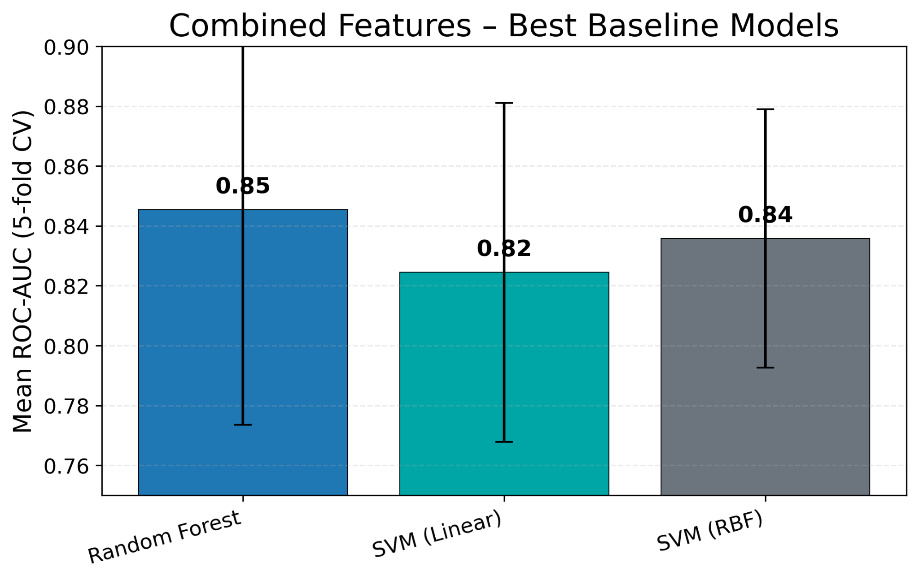
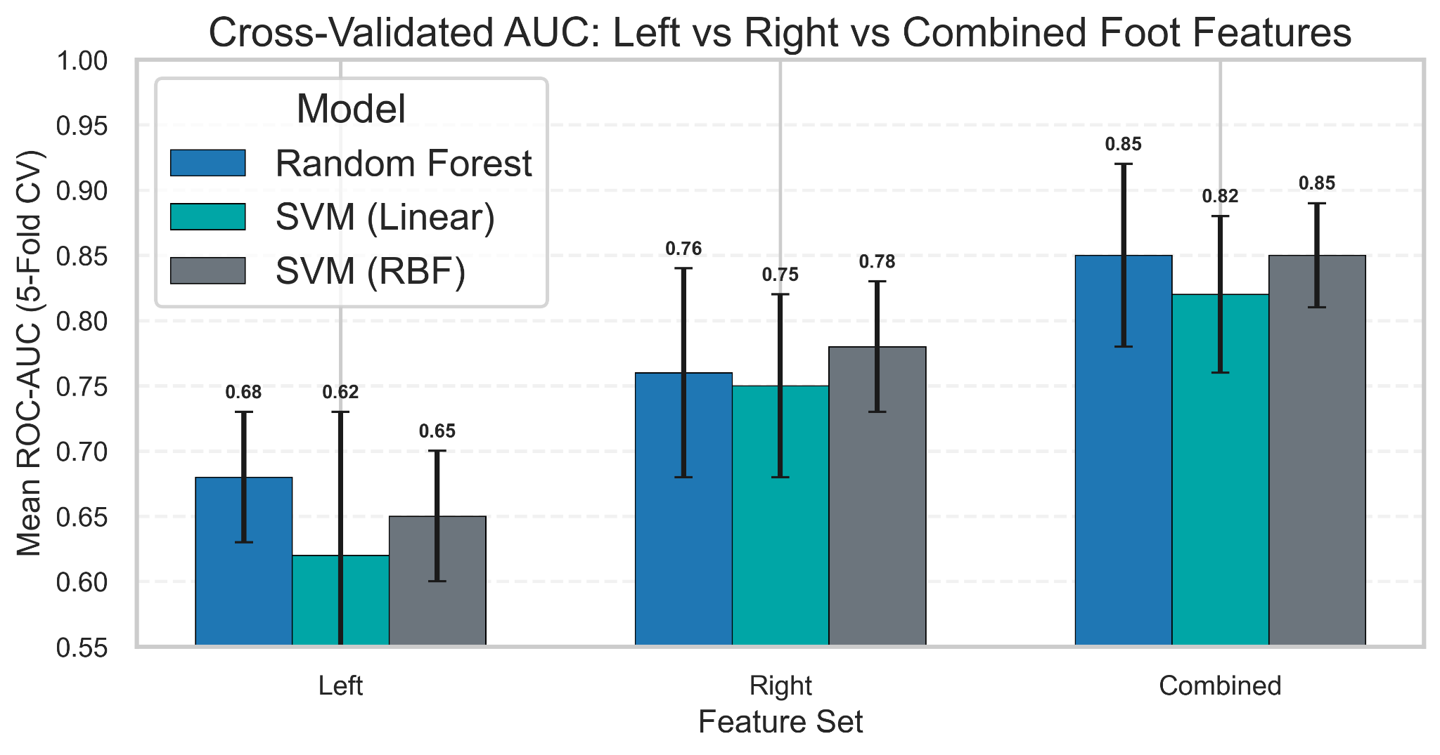
Best Performing Baseline Models (Highlights)
Combined TSFresh features with SVM-RBF/Random Forest yield strong baseline AUC (~0.84–0.85), clearly outperforming single-foot models.
Combined features yield the best baselines; RF and SVM-RBF are close at ~0.84–0.85 AUC.
Left < Right < Combined in AUC across all models, confirming benefit of using both feet.
Combined TSFresh features (L+R) clearly outperform Left or Right alone.
SVM-RBF and Random Forest are the strongest classical baselines.
This Combined + SVM-RBF / Random Forest configuration is the strongest performer.

Slide 14
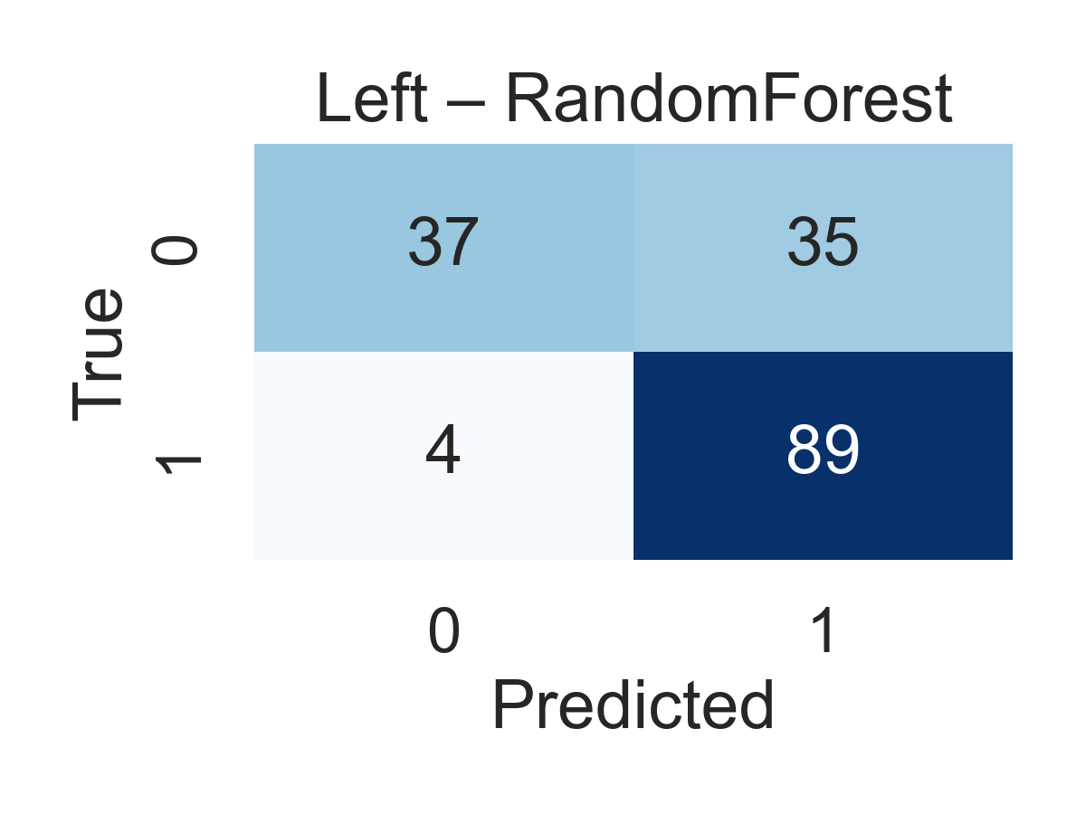
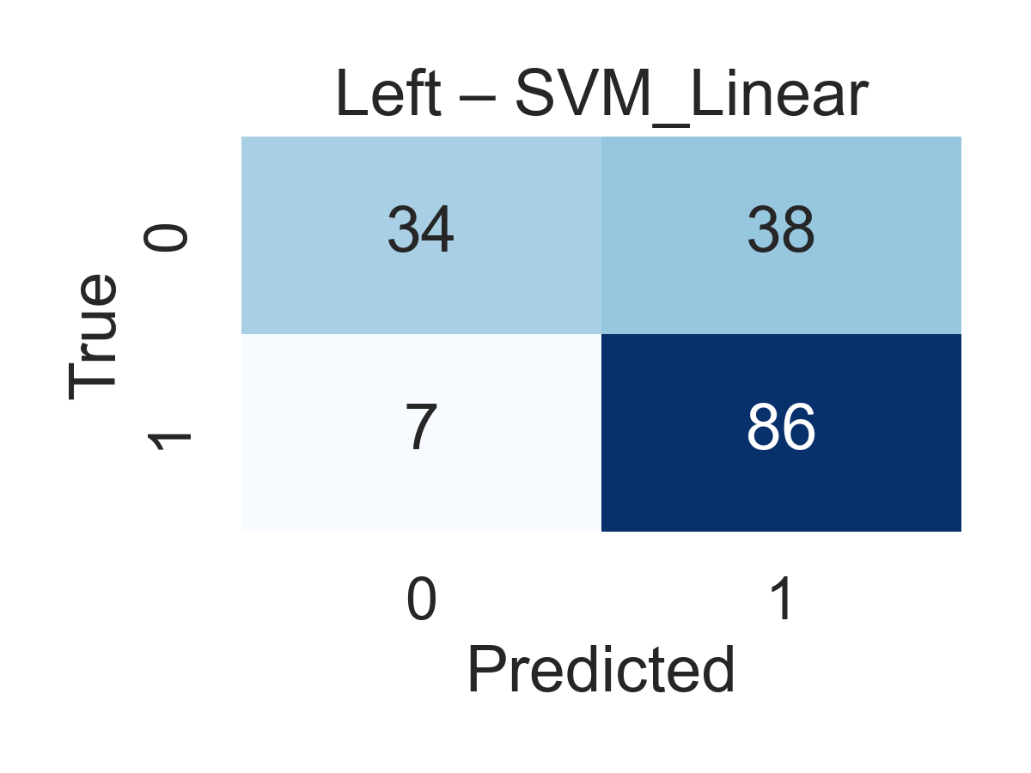
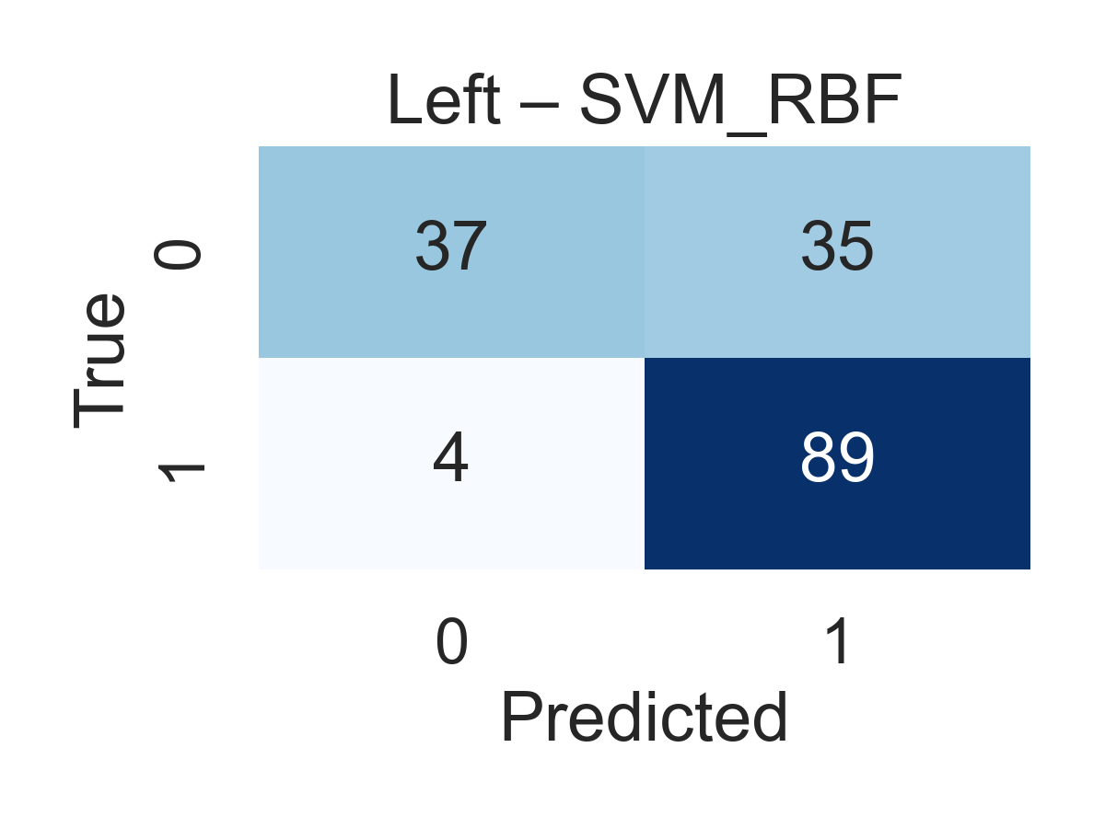
Left Foot – Confusion Matrices
High PD sensitivity but systematically misclassifies HC → biased boundary.
Linear model fails to capture gait complexity → highest FP + FN.
Slight non-linear improvement, but HC/PD separability remains weak.
Takeaways:
Left Foot is objectively the weakest feature set, regardless of model.
All classifiers converge to the same limitation → poor HC specificity.
Indicates that left-foot vGRF dynamics alone are insufficient for reliable PD–HC classification.

Slide 15
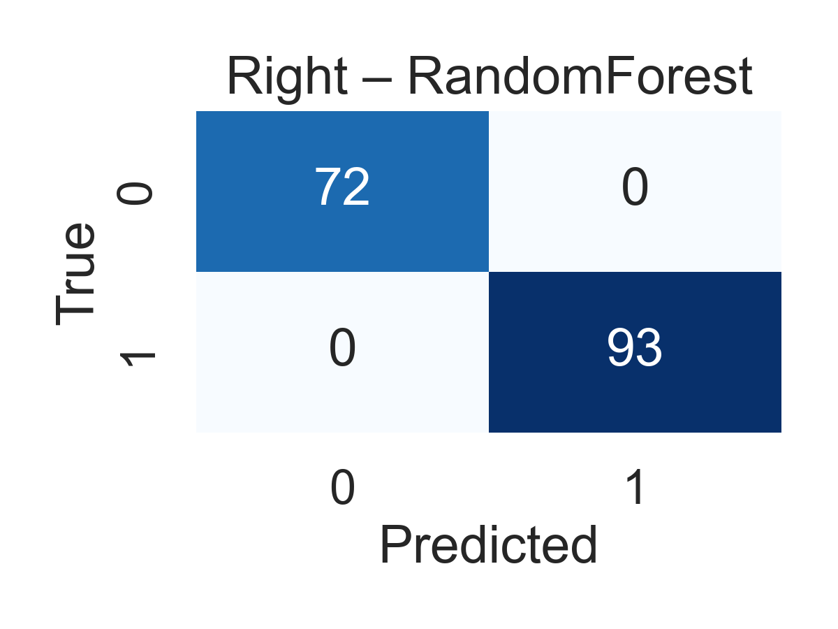
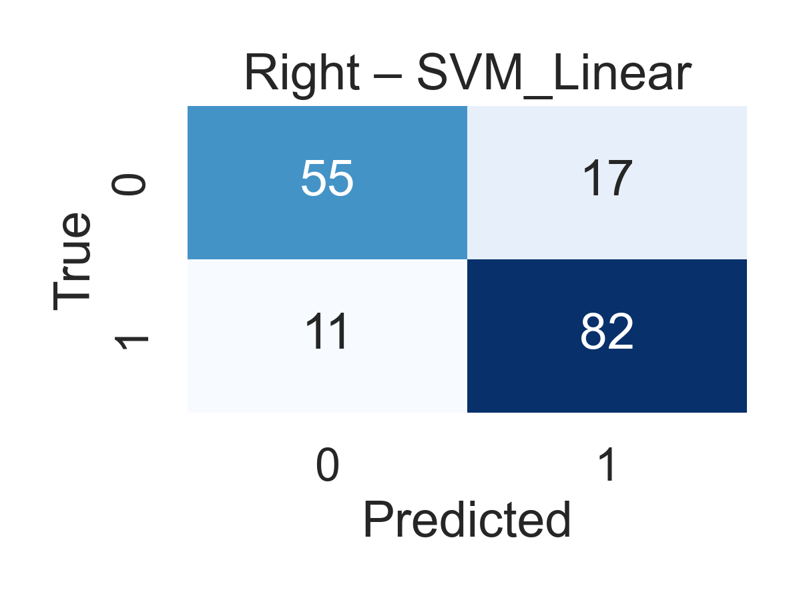
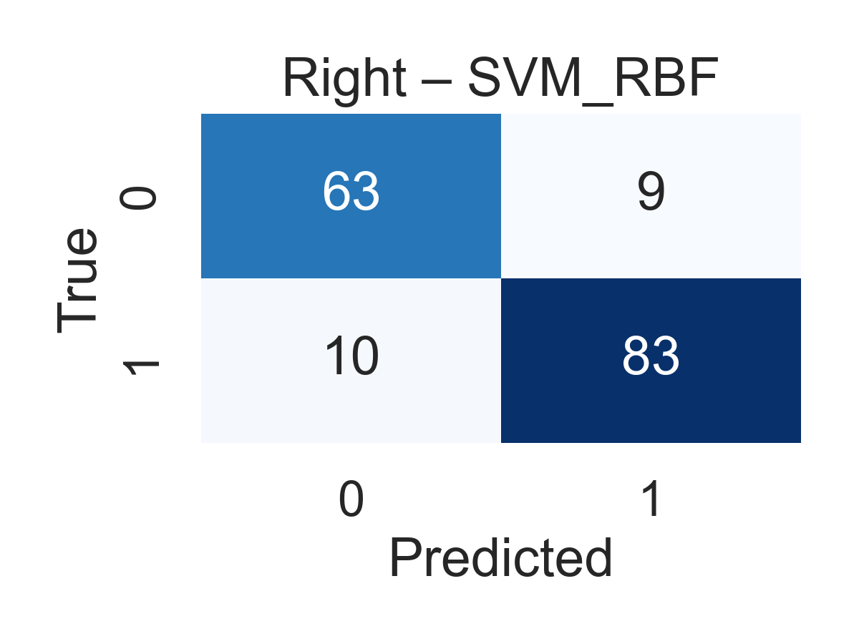
Right Foot – Confusion Matrices
Near-perfect class separation, capturing dominant PD–HC gait markers.
Linearity inadequate → misalignment with true decision surface.
Strong non-linear fit; small residual FP/FN indicate minor boundary overlaps.
Takeaways:
Right Foot is the strongest single-foot feature set, outperforming Left Foot by a large margin.
RandomForest achieves near-perfect classification, indicating strong signal quality in right-foot TSFresh features.
SVM_RBF is also reliable, but slightly less accurate than RF.
Linear SVM underperforms → confirms that PD vs HC separation is non-linear in right-foot dynamics

Slide 16
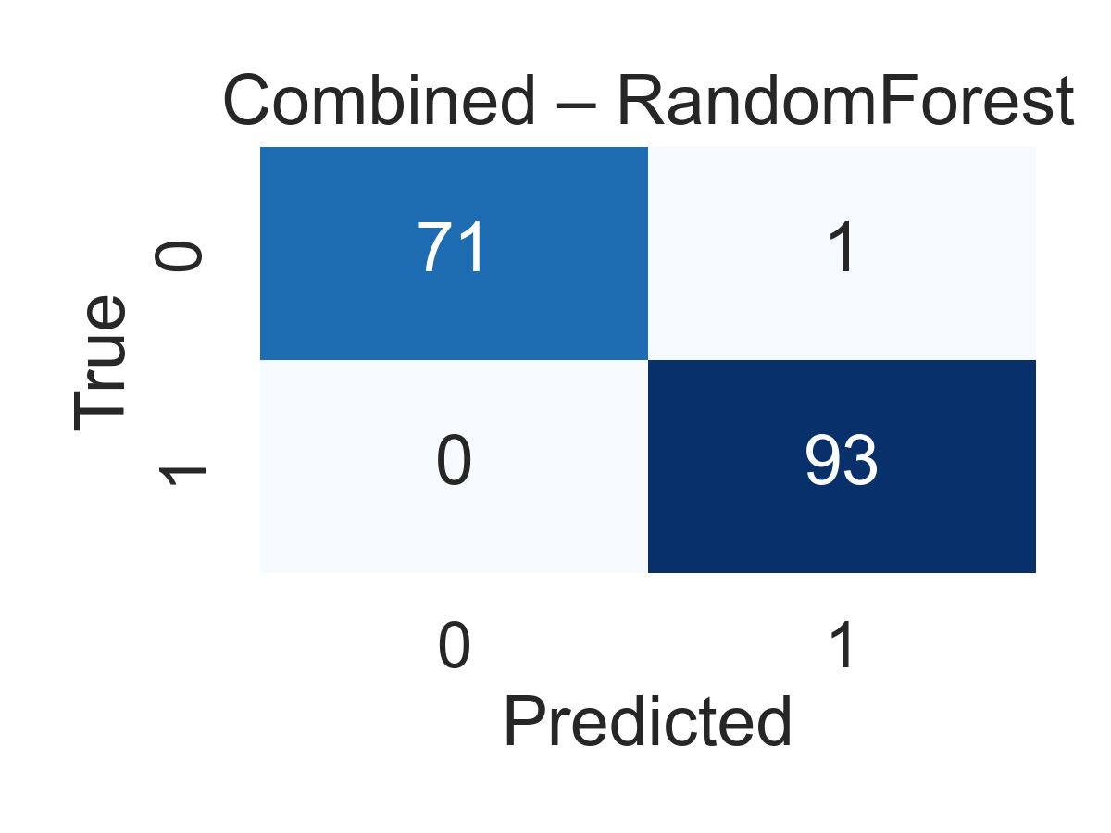
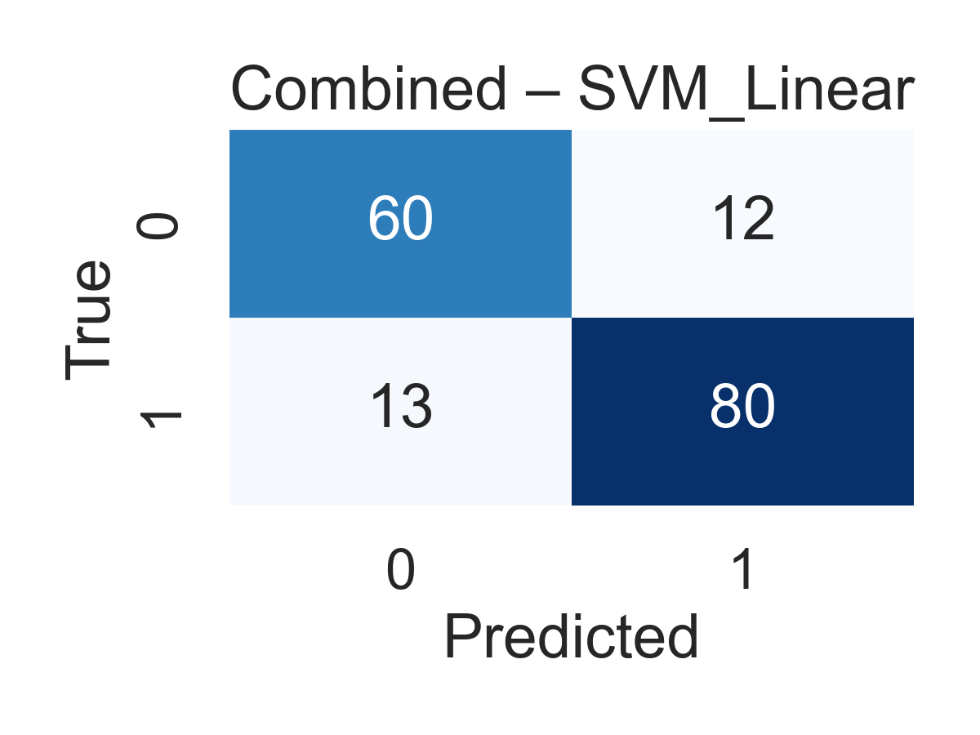
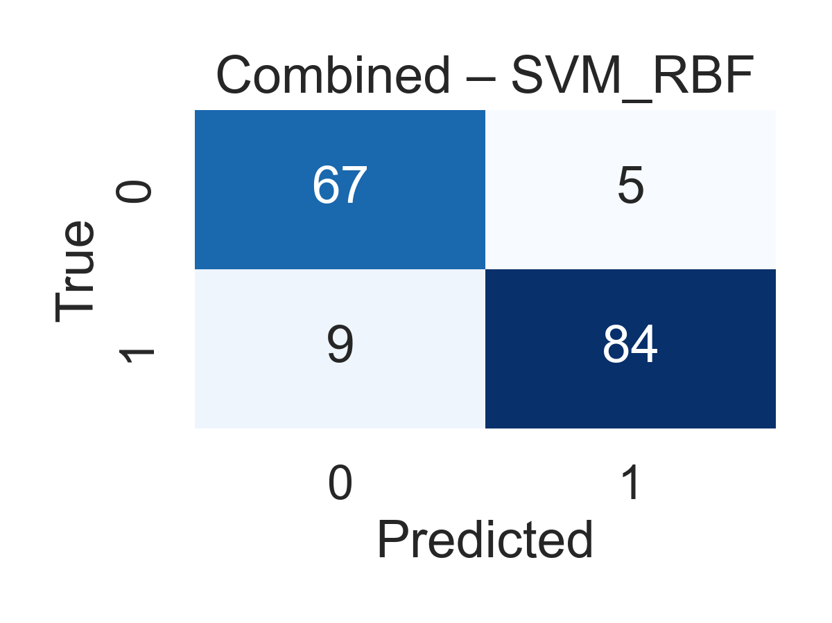
Combined Feet – Confusion Matrices
Minimal errors (1 FP, 0 FN) → robust integration of bilateral gait cues.
Underfits the expanded feature space → largest error inflation.
Stable and balanced, capturing joint foot dynamics with low misclassification.
Takeaways:
Combined feet features are the strongest overall representation, improving both HC + PD classification.
RandomForest performs best, achieving near-perfect separation.
SVM_RBF is a strong second, confirming that non-linear structure exists in combined gait patterns.
Linear SVM fails consistently → combined features exhibit high-dimensional non-linearity.

Slide 17
Conclusions, Limitations & Future Work
Summary · Key Findings · Next Steps
KEY CONCLUSIONS
LIMITATIONS
FUTURE DIRECTIONS
Right Foot > Left Foot -> clearer PD–HC separation, stronger discriminative patterns
Small dataset (n=166) — limits generalization to larger populations
Apply State Space Models (Mamba) to raw vGRF sequences
Combined bilateral features outperform single-foot across ALL classifiers
TSFresh aggregation loses temporal ordering of gait events
Explore LDA for supervised dimensionality reduction
Non-linear models (RF, SVM-RBF) best capture PD–HC gait differences
Left-foot specificity low (0.40–0.45) — possible HC compensation effect
Representation learning: Use self-supervised or deep embedding methods to learn richer gait signatures
TSFresh automation provides rich, reproducible features without manual design
Classical ML cannot model cross-foot coordination dynamically
Validate on larger multi-site PD gait datasets
OVERALL TAKEAWAY
BEST BASELINE — Combined + SVM-RBF (Nested CV)
KEY CONCLUSIONS
Classical ML + TSFresh delivers solid, interpretable baseline above 75% accuracy threshold
→
77%
0.85
78%
72%
Bilateral gait asymmetry is the key discriminative signal — both feet essential
→
Accuracy
AUC
Sensitivity
Specificity
Temporal modeling gap motivates Mamba / SSM for future sequence-based analysis
Unbiased estimate via 5-fold outer / 3-fold inner nested cross-validation · n=166
→

Slide 18

Any Questions ?
THANK YOU

